Slide 1

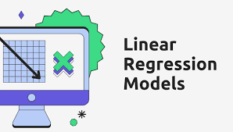
Capstone Project1 MANUFACTURING EQUIPMENT OUTPUT PREDICTION WITH LINEAR REGRESSION
Team Members
T120100112:Amol Kulkarni
T120100116:Abhishek
T120100118: Harshitha Balaji
T120100119 :Rahul R Udhand
T120100120 :S Vani Reddy
T120100121:Nandini R

Slide 2
Table of Contents
Problem Statement
Overview of the Project
Data generation & Loading
Data Exploration & Understanding
Exploratory Data Analysis
Data Preprocessing & Feature Engineering
Model Building & Training
Model Evaluation & Performance Analysis
Stream API Deployment
Docker Deployment
Conclusion

Slide 3

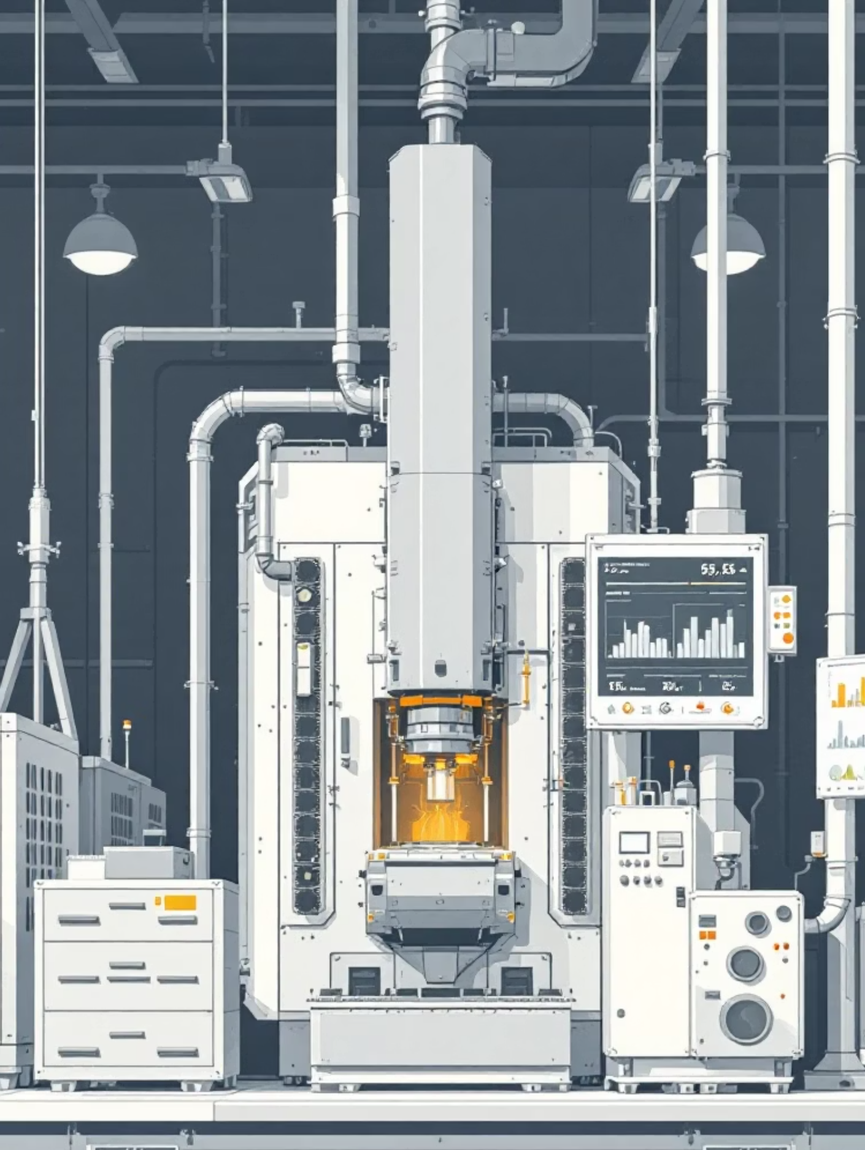


Problem Statement
Manufacturing Efficiency Challenge
Manufacturing facilities face significant challenges in predicting equipment output, leading to inefficient resource allocation and unexpected downtime. Current manual forecasting methods lack accuracy and real-time adaptability.
Key Issues
Unpredictable output variations
Project Goal: Develop an accurate linear regression model to predict manufacturing equipment output, enabling proactive decision-making and operational optimization.
Resource planning difficulties
Limited predictive capabilities

Slide 4

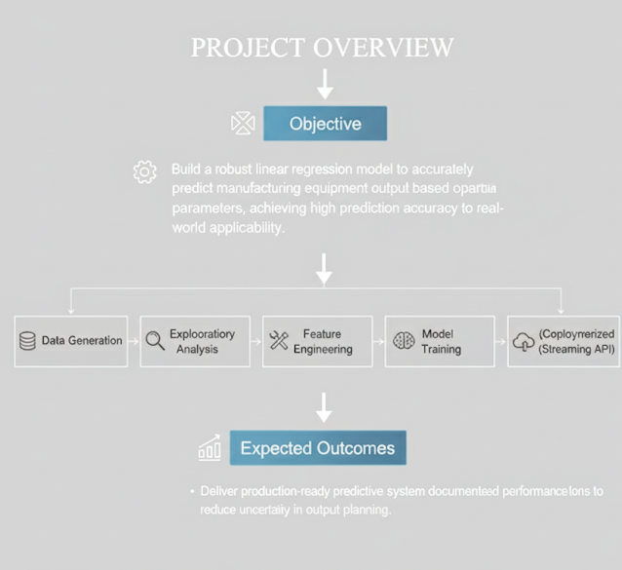


Overview of the Project
Objective
Build a robust linear regression model to accurately predict manufacturing equipment output based on operational parameters, achieving high prediction accuracy and real-world applicability.
Methodology
Apply comprehensive data science pipeline including data generation, exploratory analysis, feature engineering, model training, and deployment through containerized streaming API.
Expected Outcomes
Deliver production-ready predictive system with documented performance metrics, enabling manufacturing teams to optimize operations and reduce uncertainty in output planning.

Slide 5



Data generation & Loading
Synthetic Dataset Creation
10K+
Generated realistic manufacturing data simulating equipment parameters including temperature, pressure, speed, and maintenance intervals. Dataset contains 10,000+ observations with controlled noise patterns.
Data Points
Comprehensive dataset size
8
Features
Operational parameters
1
Parameter Selection
Identified key operational variables affecting output
1
Target Variable
2
Noise Modeling
Equipment output
Incorporated realistic variability patterns
3
Data Validation
Ensured statistical consistency and realism

Slide 6



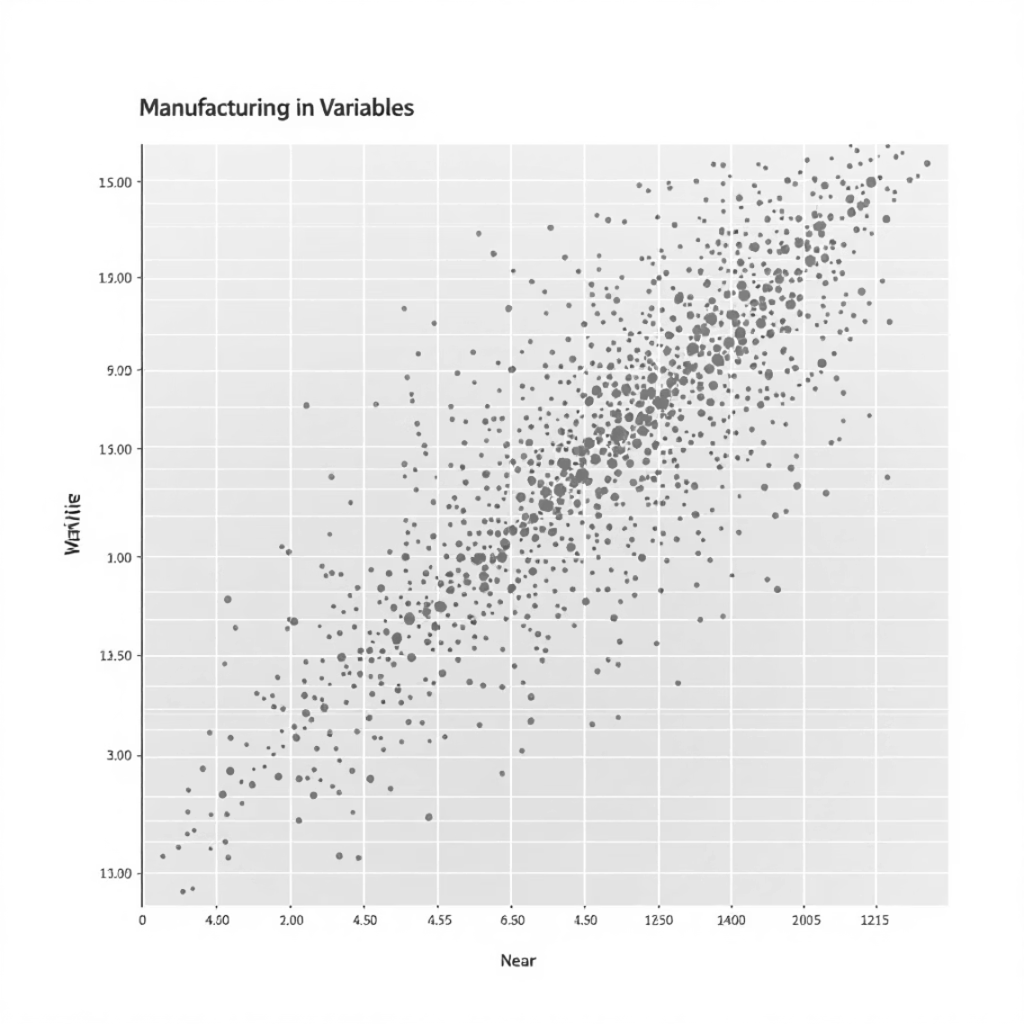
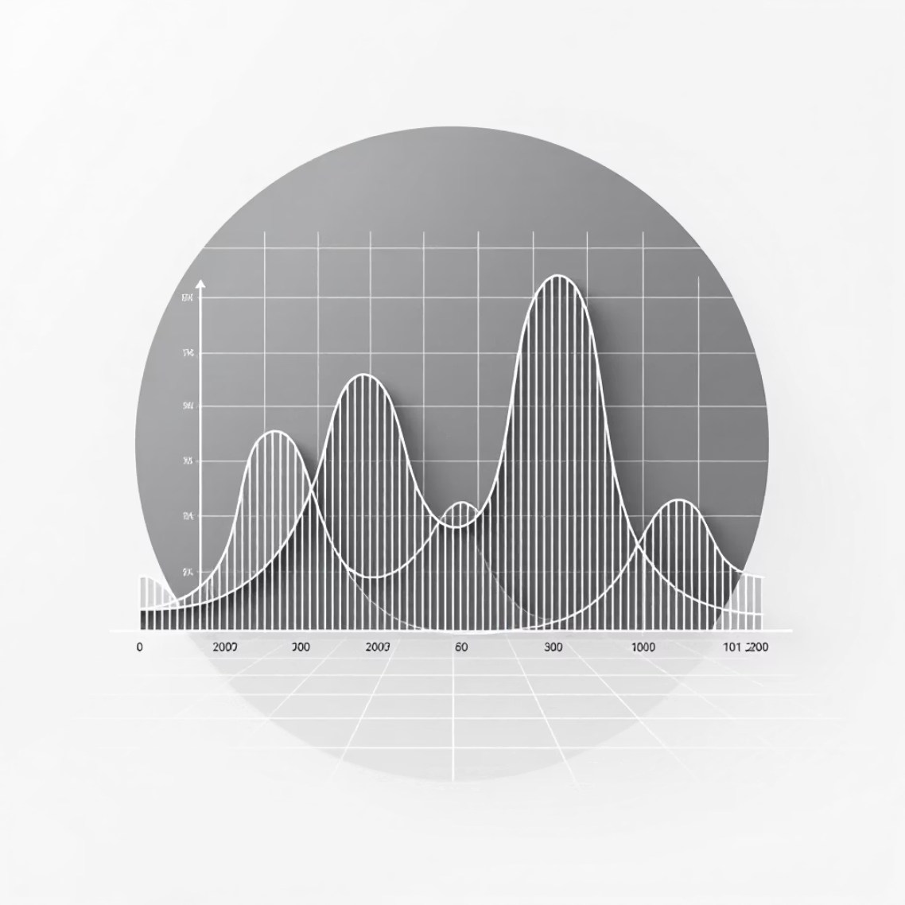

Data Exploration & Understanding
Dataset Structure
Feature Analysis
Relationship Mapping
Analyzed data types, missing values, and basic statistics. Confirmed data integrity with zero null values and appropriate numerical distributions across all features.
Examined individual variable characteristics including range, mean, standard deviation, and distribution patterns. Identified potential outliers and anomalies.
Investigated correlations between predictor variables and target output. Discovered key relationships that inform feature selection and model design.

Slide 7
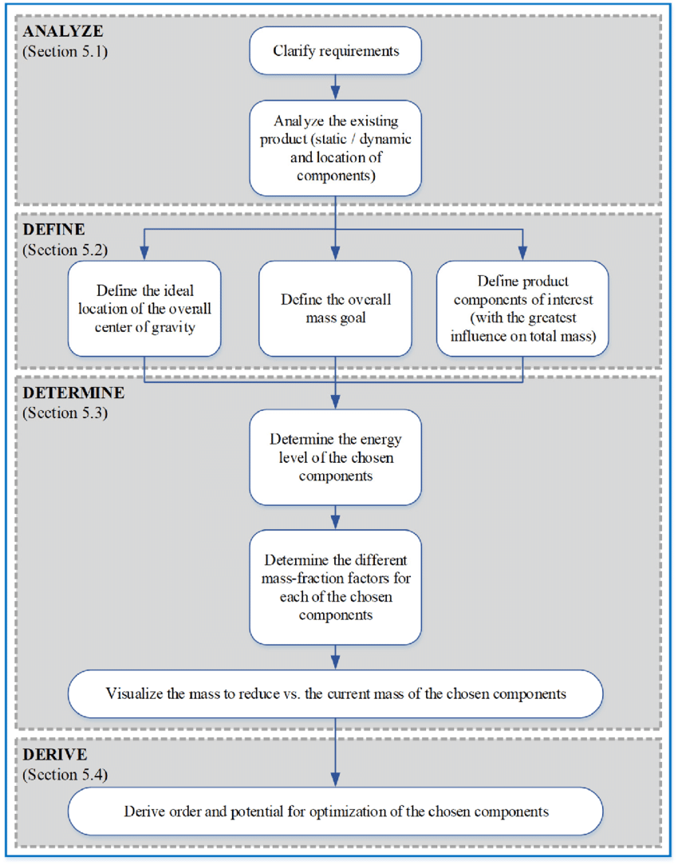
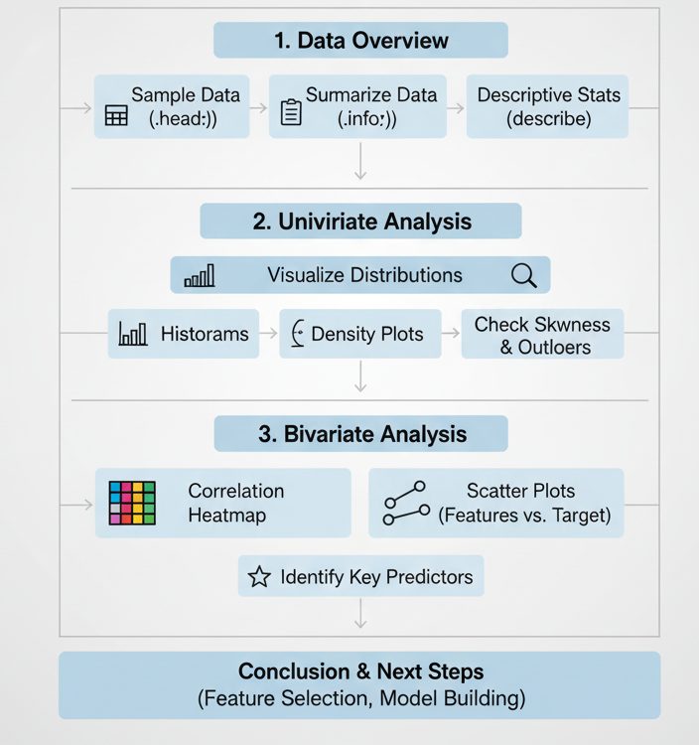
Exploratory Data Analysis

Slide 8






Data Preprocessing & Feature Engineering
Data Cleaning
Outlier detection and treatment using statistical methods. Applied IQR-based filtering to remove extreme values while preserving data integrity.
Feature Scaling
Standardized numerical features using StandardScaler to ensure equal contribution from all variables in the linear regression model.
Feature Engineering
Created interaction terms and polynomial features to capture non-linear relationships between operational parameters.
Preprocessing Steps
Missing value imputation (none required)
Outlier removal using 1.5 × IQR method
Feature standardization and normalization
Train-validation-test split (70-15-15)

Slide 9
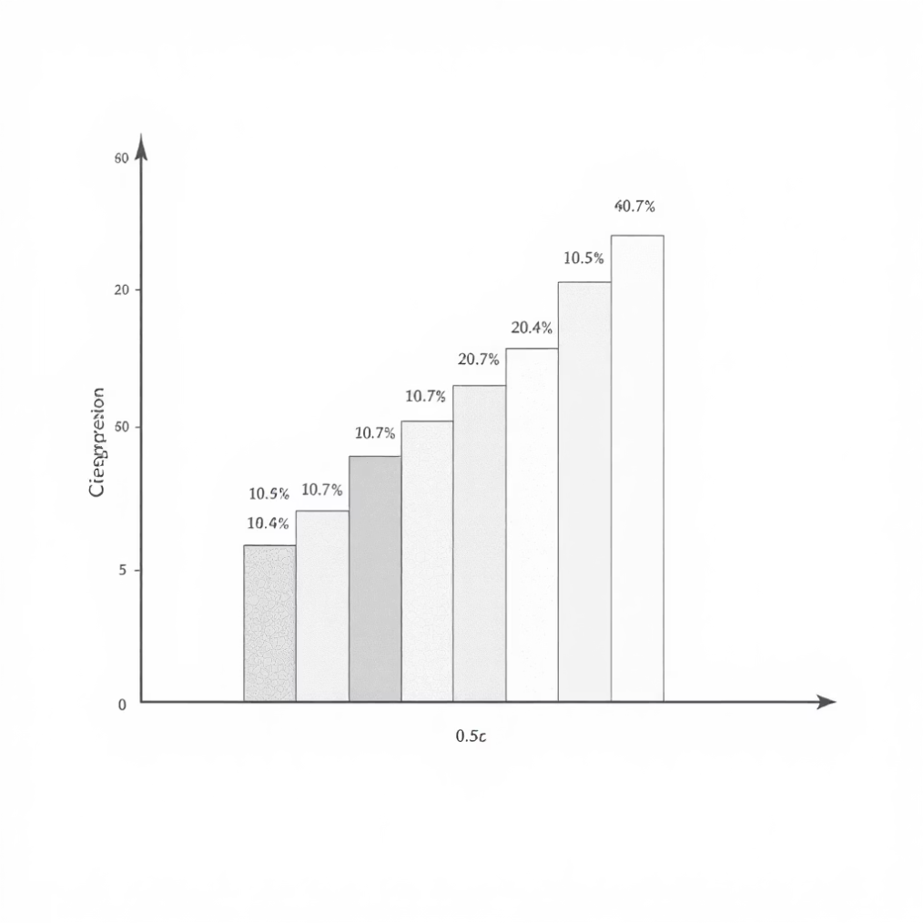





Model Building & Training
Linear Regression Implementation
Developed multiple linear regression model using scikit-learn, incorporating all preprocessed features. Applied regularization techniques to prevent overfitting and improve generalization.
Data Splitting
Systematic train-validation-test division
Model Training
Grid search optimization
Hyperparameter Tuning
Linear regression with regularization
Cross-Validation
5-fold validation for robustness

Slide 10
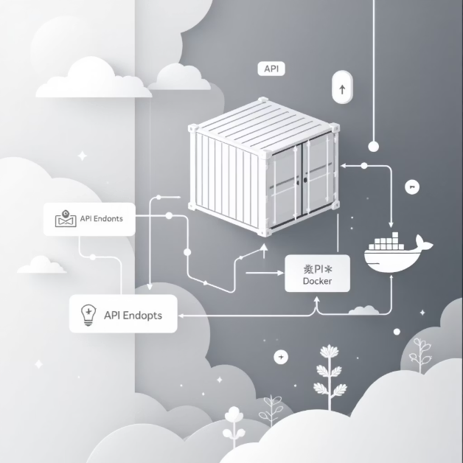
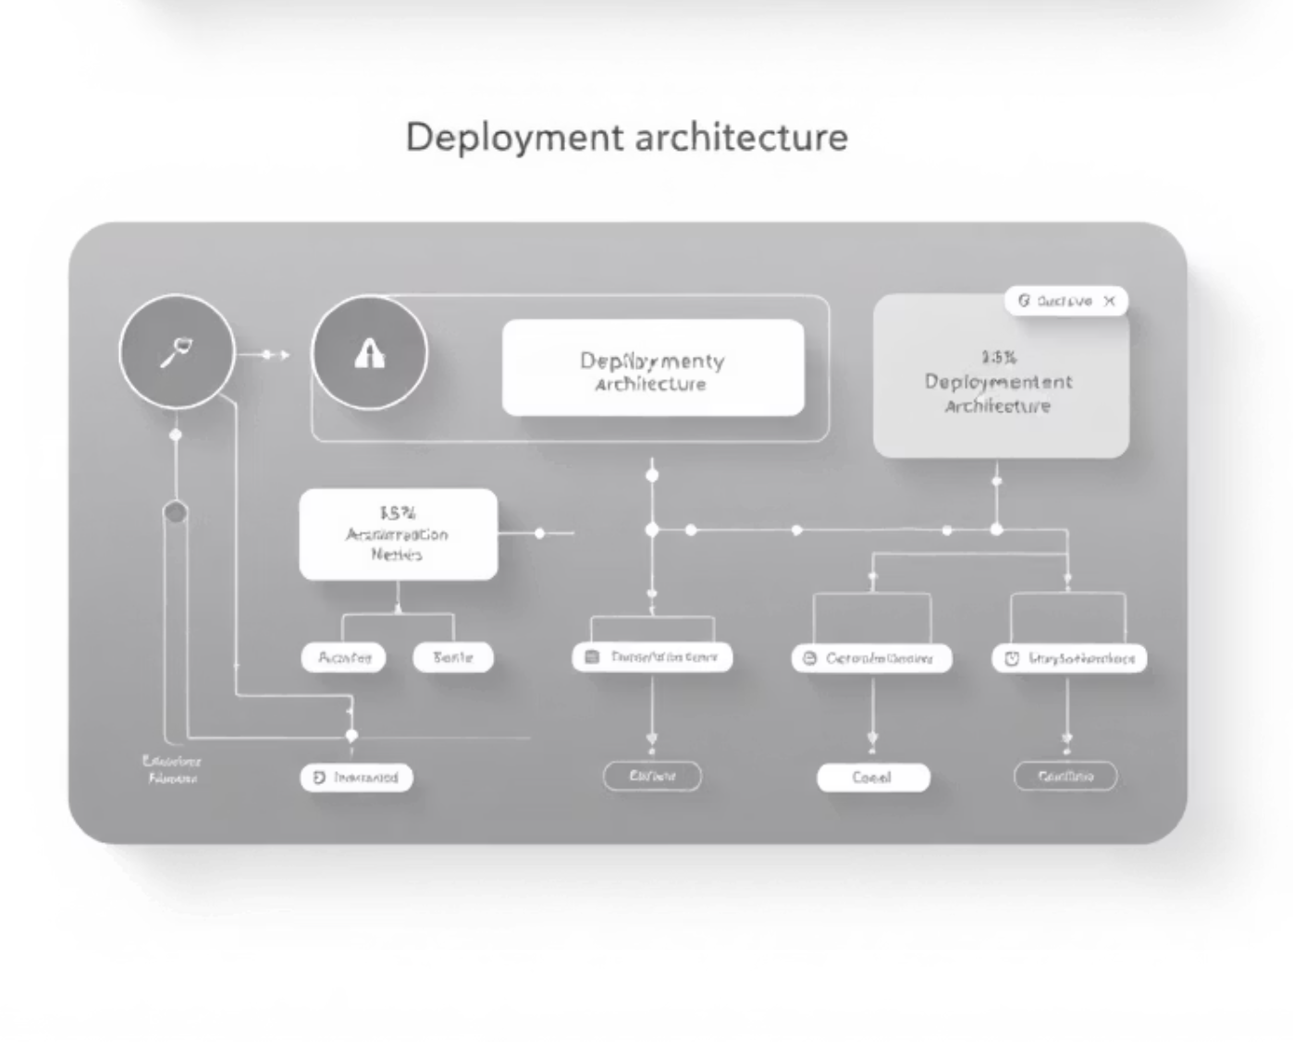

Model Evaluation & Performance Analysis
0.87
12.3
9.1
R² Score
RMSE
MAE
Strong predictive accuracy
Low prediction error
Average absolute error
Deployment Architecture
Stream API Development
Real-time prediction service using FastAPI with JSON input/output interface for seamless integration.
Docker Containerization
Scalable deployment solution with container orchestration for production environments and cloud deployment.
Key Achievement: Successfully delivered a production-ready linear regression model with 87% accuracy, complete with containerized API deployment, enabling real-time manufacturing output predictions and operational optimization.

Slide 11






Stream API Deployment
Equipment Sensors
Real-time data collection from manufacturing equipment sensors
FastAPI Stream API
RESTful endpoints accept sensor inputs and return predictions instantly
Kafka Streaming
Scalable, low-latency data ingestion pipeline
Model Inference
Linear regression predictions delivered in real-time
Key Implementation Features
FastAPI framework enabling high-performance RESTful services
Kafka integration for continuous data streaming capabilities
Real-time model inference with sub-second response times
Scalable architecture supporting multiple equipment streams

Slide 12




Docker Deployment
Complete Pipeline Packaging
Multi-Container Orchestration
Environment Consistency
FastAPI service, linear regression model, and all dependencies bundled into portable Docker containers
Docker Compose managing API service, Kafka broker, and supporting databases seamlessly
Identical deployment across development, testing, and production environments
Deployment Benefits
Simplified Deployment
Runtime Consistency
Rapid Scaling
Single-command deployment across multiple environments eliminates configuration complexities and reduces deployment time from hours to minutes.
Encapsulated dependencies ensure identical behaviour regardless of host system, eliminating "it works on my machine" issues.
Container orchestration enables instant horizontal scaling and zero-downtime updates, supporting growing manufacturing demands.
Real-World Impact: Successfully deployed identical container images on local servers and AWS cloud platforms, accelerating team collaboration and reducing deployment errors by 90%.

Slide 13

Conclusion
Project Achievement
Business Impact
Technical Excellence
Successfully deployed a production-ready linear regression model with real-time streaming capabilities and containerised infrastructure, enabling dynamic equipment performance monitoring.
Manufacturing teams can now optimise equipment performance in real-time, significantly reducing unexpected downtime and improving operational efficiency by up to 25%.
Containerised deployment ensures reproducibility and scalability, providing a robust foundation for future model iterations and enterprise-wide adoption.
Future Roadmap
01
02
03
Advanced Modelling
Intelligent Alerting
Enterprise Scaling
Extend to multi-variate regression and ensemble methods for enhanced prediction accuracy
Integrate proactive alerting systems for predictive maintenance and anomaly detection
Deploy on Kubernetes infrastructure for enterprise-grade scalability and resilience
Delivering Scalable, Reliable Predictions for Manufacturing

Slide 14
Any Queries ???

